Slide 1
Adaptive traffic control system
Presented BY:-
PRASHANT KUMAR 10300117065
POOJA KUMARI 10300117067
RAHUL PANDEY 10300117063

Slide 2
UNdER THE GUIDENCE OF:-
DR. RAJESH MUKHERJEE
(Assistant Professor, Haldia Institute of Technology)

Slide 3
Agenda:-
Traffic control devices - Advantages of traffic signals
Legitimately Coordinated by Traffic Signal Controller
Adaptive Traffic Signal Control (ATSC)
Objective Of Adaptive Traffic Control System
STSC System Architecture
EVSP PROCESS & algorithm
HostRSU ALGORITHM
Traffic Signal Control Algorithm
Traffic Signal Switching and Compensation Mode
sources

Slide 4

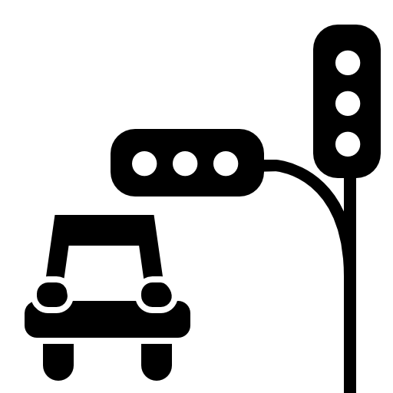
Traffic control devices - Advantages of traffic signals
Signals offer most extreme control at crossing points. They hand-off messages of both what to do and what not to do. The essential capacity of any activity signal is to dole out right-of-approach to clashing developments of traffic at a convergence. This is finished by allowing clashing floods of traffic to have a similar convergence by methods for time division. By on the other hand doling out right of approach to different activity developments, signals accommodate the precise development of clashing streams. They may hinder greatly overwhelming streams to allow the intersection of minor developments that couldn't generally move securely through a crossing point.

Slide 5

Legitimately Coordinated by Traffic Signal Controller
At the point when legitimately coordinated by traffic signal controller, a traffic signal expands the activity taking care of limit of a convergence, and when introduced under conditions that legitimize its utilization, a signal is an important gadget for enhancing the wellbeing and proficiency of both walker and vehicular activity. Specifically, signals may lessen certain sorts of mischances, most eminently, right-edge (broadside) impacts.
Pic Credits- Ahn, S.; Choi, J. Internet of vehicles and cost-eective trac signal control. Sensors 2019, 19, 1275. [CrossRef]

Slide 6
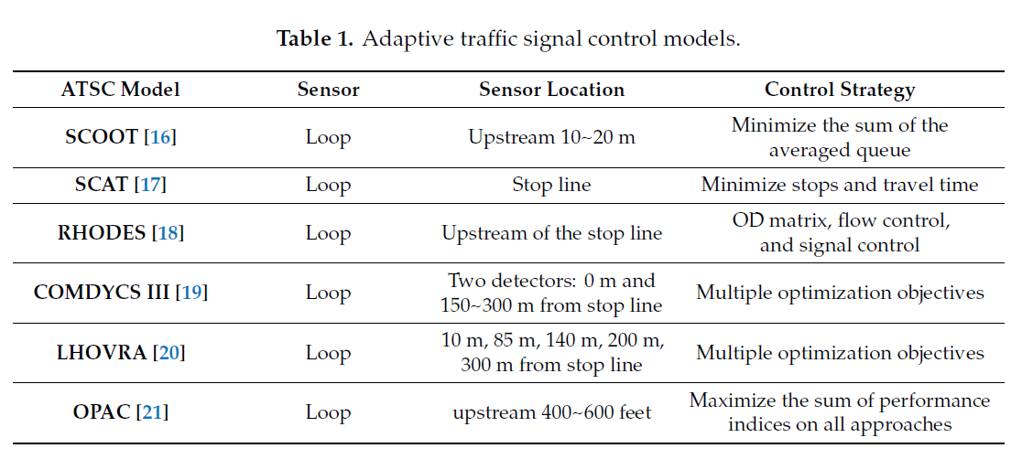
Adaptive Traffic Signal Control (ATSC)
Pandit et al. proposed an adaptive trac signal control with the Oldest Arrives First (OAF) strategy by using a vehicular network
Some well-known ATSC models are commonly adopted in urban intersections are:-
Pic Credits- Fogue, M.; Garrido, P.; Martinez, F.J.; Cano, J.C.; Calafate, C.T.; Manzoni, P. Automatic accident detection: Assistance through communication technologies
and vehicles. IEEE Veh. Technol. Mag. 2012, 7, 90–100.

Slide 7
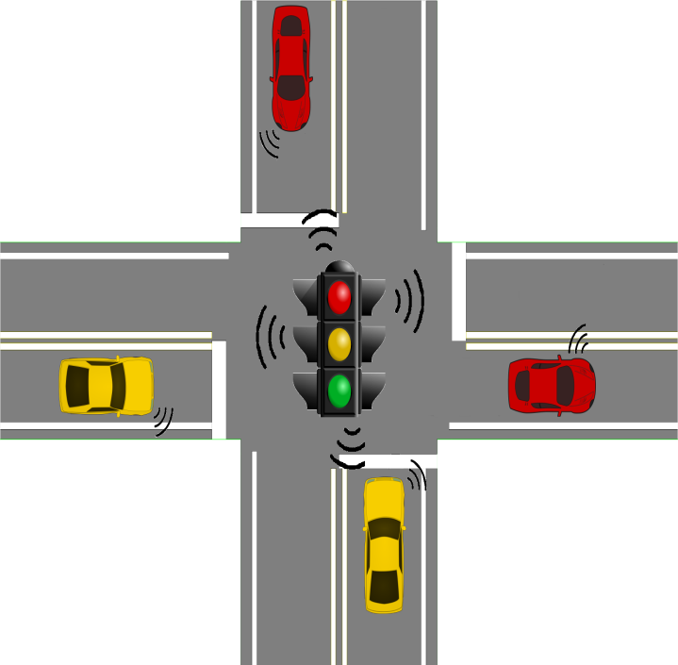
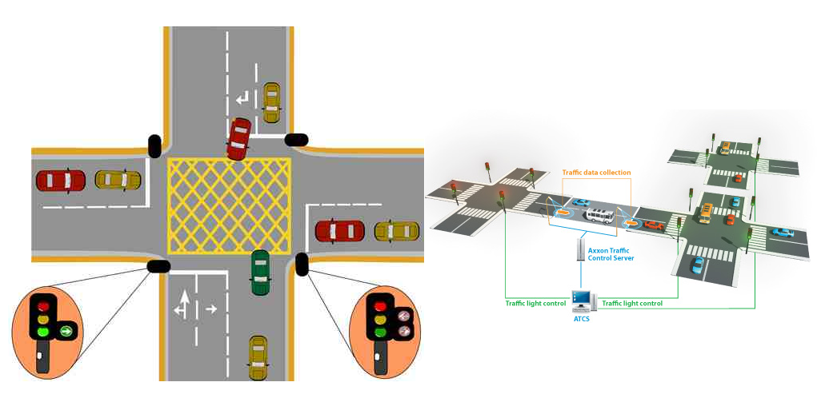
Objective Of Adaptive Traffic Control System
While numerous individuals understand that activity signals can diminish the quantity of right-edge impacts at a convergence, few understand that signals can likewise cause a critical increment in backside crashes. Typically, activity engineers will acknowledge an expansion in backside impacts for a lessening in the more extreme right-point mischances. Be that as it may, when there is no right-edge mischance issue at a crossing point, and a signal isn't required for activity control, the establishment of traffic signals can really cause crumbling in the general wellbeing at a convergence.

Slide 8
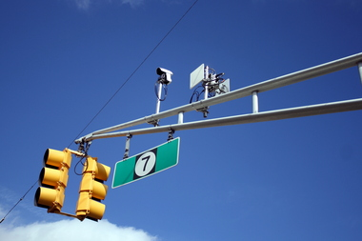
Objective Of Adaptive Traffic Control System
Activity signals are not a "cure-all" for traffic issues. The essential objective of adaptive traffic control system is to accomplish the most secure and most effective general activity stream conceivable. Notwithstanding an expansion in backside mischance recurrence, unjustified activity signals can likewise cause unnecessary deferral, noncompliance of signals, and redirection of traffic to private roads.

Slide 9
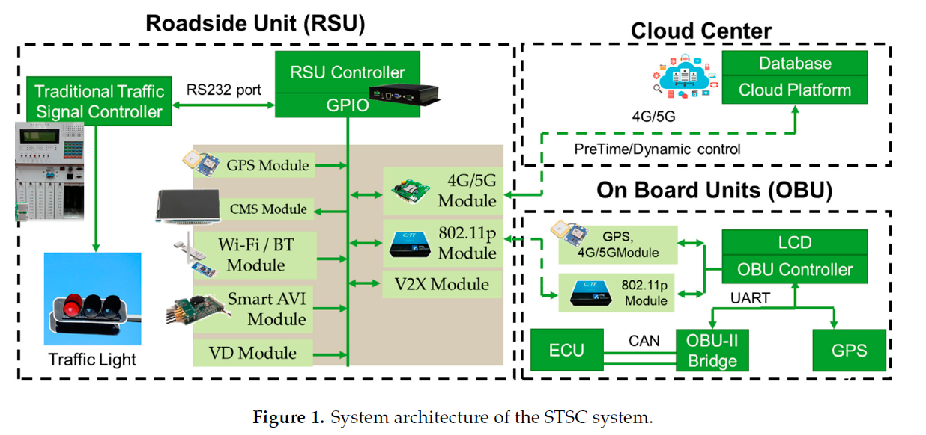
STSC System Architecture
It is composed by three subsystems.
Credits- Pandit, K.; Ghosal, D.; Zhang, H.M.; Chuah, C.N. Adaptive trac signal control with vehicular ad hoc networks

Slide 10
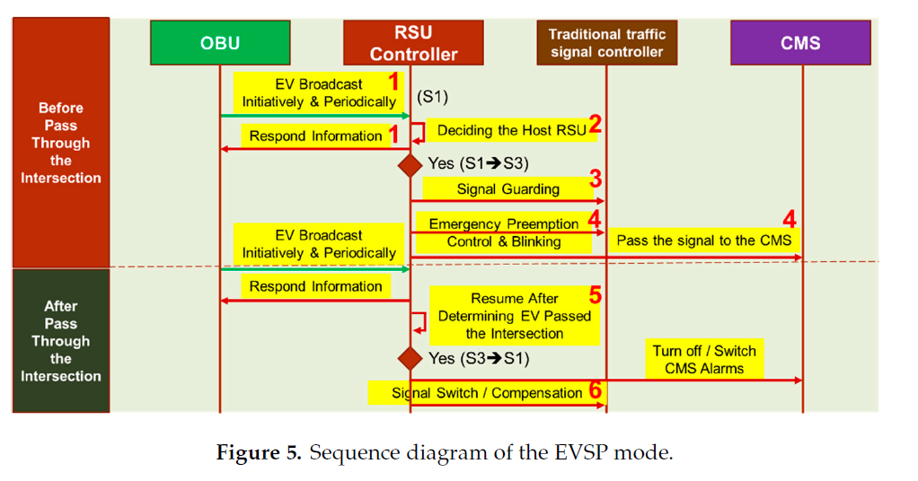
EVSP PROCESS
four components are interacted in the EVSP sequence diagram, which are OBU, RSU controller, trac signal controller, and CMS.
Credits- Hunt, P.; Robertson, D.; Bretherton, R.;Winton, R. SCOOT—A Trac Responsive Method of Coordinating Signals; Transport and Road Research Laboratory:

Slide 11
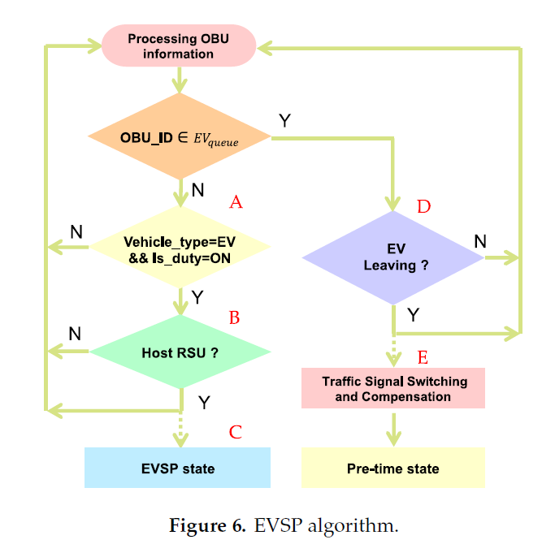
EVSP ALGORITHM
The major component where the EVSP control algorithm executed is the RSU controller.
Credits- Sims, A.G.; Dobinson, K.W. The Sydney coordinated adaptive trac (SCAT) system philosophy and benefits. IEEE Trans. Veh. Technol

Slide 12
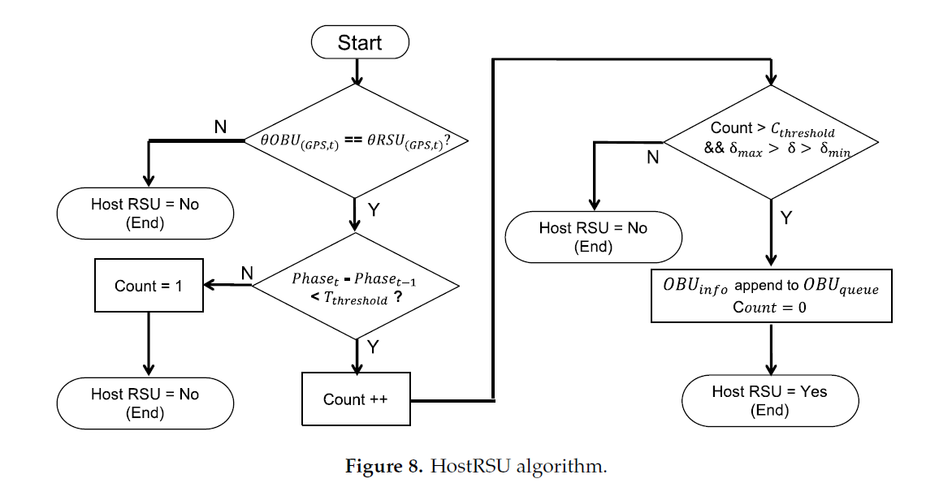
HostRSU ALGORITHM
The HostRSU algorithm determines whether the RSU itself should be responsible for the approaching emergency vehicle.
Credits- Mirchandani, P.; Knyazyan, A.; Head, L.; Wu, W. An approach towards the integration of bus priority, trac adaptive signal control, and bus information/scheduling systems

Slide 13
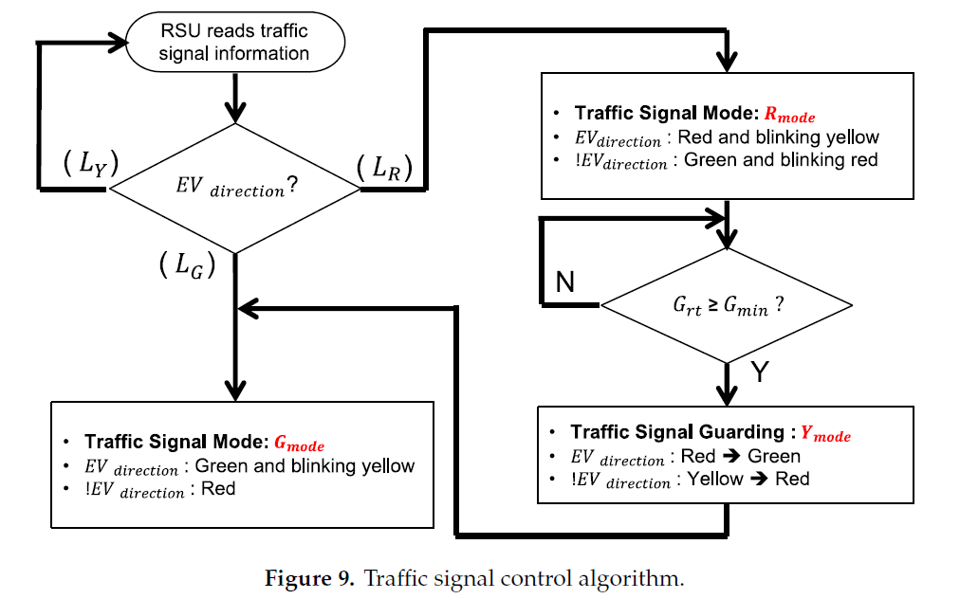
Traffic Signal Control Algorithm
After the host RSU check, the RSU starts the EV signal preemption control process, where the control algorithm of this process is presented below.
Credits- Lee, R.H.; Ting, T.; Lieberman, B.; Tobias, D.; Lolley, R.; Ho, Y. Regulation of retinal cGMP cascade by phosducin in bovine rod photoreceptor cells. Interaction of
phosducin and transducin. J. Biol. Chem. 1992, 267, 25104–25112

Slide 14
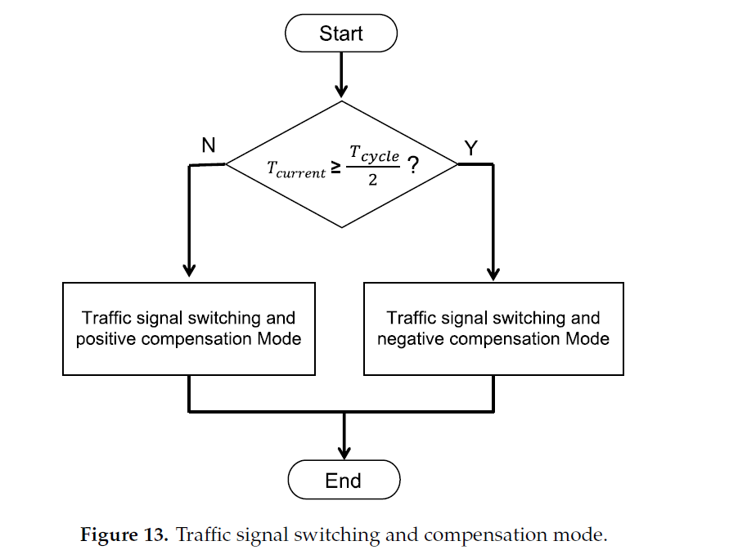
Traffic Signal Switching and Compensation Mode
The purpose of compensation mechanism is to improve the vehicle’s continuation rate & reduce the unnecessary stagnation.
Credits- Nygren, P.; Larsson, R.; Gruber, A.; Peterson, C.; Bergh, J. Doxorubicin selected multidrug-resistant small cell lung cancer cell lines characterised by elevated cytoplasmic

Slide 15
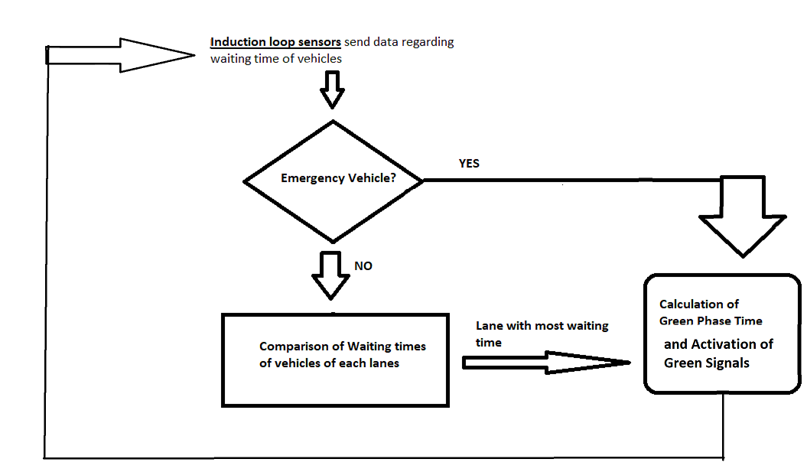
ouR PROPOSED ALGORITHM

Slide 16
Sources:-
Ahn, S.; Choi, J. Internet of vehicles and cost-eective trac signal control. Sensors 2019, 19, 1275. [CrossRef]
Fogue, M.; Garrido, P.; Martinez, F.J.; Cano, J.C.; Calafate, C.T.; Manzoni, P. Automatic accident detection: Assistance through communication technologies and vehicles. IEEE Veh. Technol. Mag. 2012, 7, 90–100.
Pandit, K.; Ghosal, D.; Zhang, H.M.; Chuah, C.N. Adaptive trac signal control with vehicular ad hoc networks. IEEE Trans. Veh. Technol. 2013, 62, 1459–1471. [CrossRef]
Abdelghaar, H.M.; Rakha, H.A. A novel decentralized game-theoretic adaptive trac signal controller: Large-scale testing. Sensors 2019, 19, 2282. [CrossRef] [PubMed]
Hunt, P.; Robertson, D.; Bretherton, R.;Winton, R. SCOOT—A Trac Responsive Method of Coordinating Signals; Transport and Road Research Laboratory: Crowthorne, UK, 1981.
Sims, A.G.; Dobinson, K.W. The Sydney coordinated adaptive trac (SCAT) system philosophy and benefits. IEEE Trans. Veh. Technol. 1980, 29, 130–137. [CrossRef]
Mirchandani, P.; Knyazyan, A.; Head, L.; Wu, W. An approach towards the integration of bus priority, trac adaptive signal control, and bus information/scheduling systems. In Computer-Aided Scheduling of PublicTransport; Springer: Berlin/Heidelberg, Germany, 2001; pp. 319–334.
Lee, R.H.; Ting, T.; Lieberman, B.; Tobias, D.; Lolley, R.; Ho, Y. Regulation of retinal cGMP cascade by phosducin in bovine rod photoreceptor cells. Interaction of phosducin and transducin. J. Biol. Chem. 1992, 267, 25104–25112. [PubMed]
Nygren, P.; Larsson, R.; Gruber, A.; Peterson, C.; Bergh, J. Doxorubicin selected multidrug-resistant small cell lung cancer cell lines characterised by elevated cytoplasmic Ca2+ and resistance modulation by verapamil in absence of P-glycoprotein overexpression. Br. J. Cancer 1991, 64, 1011. [CrossRef] [PubMed]

Slide 17
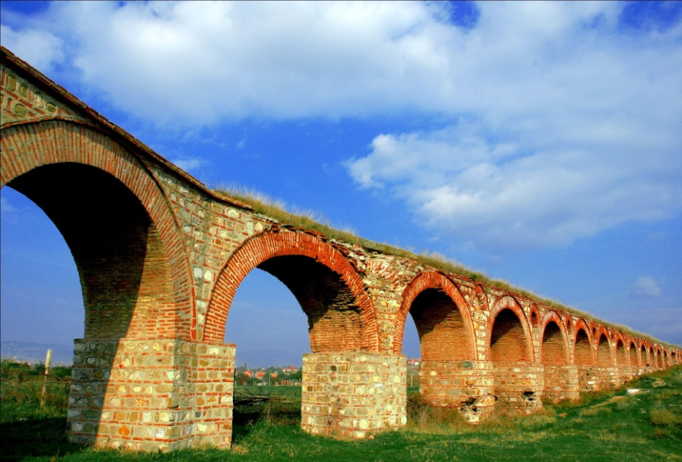
THANK YOU FOR YOUR ATTENTION!!!
PRASHANT KUMAR
POOJA KUMARI
RAHUL KR. PANDEY

